Slide 1


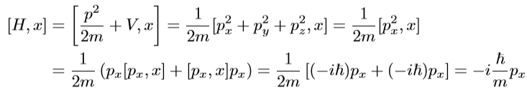
Problem 4.1 page 133:
(a)
(b)

Slide 2






(c)

Slide 3



Problem 4.2 page 135:
(a)
Let:

Slide 4
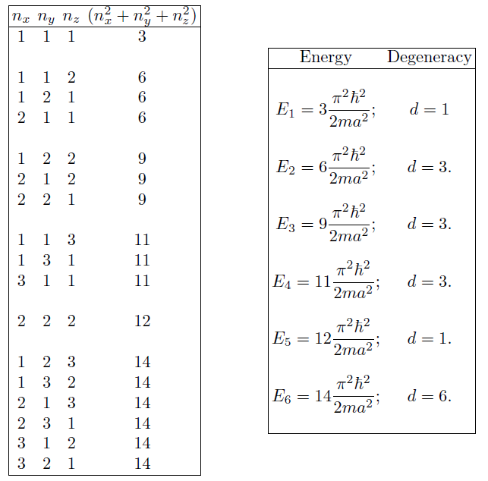
(b)
(c). Degeneracy is 4, (333)(511)

Slide 5







Problem 4.3 page 139:

Slide 6





Problem 4.4 page 139:
What’s wrong?

Slide 7
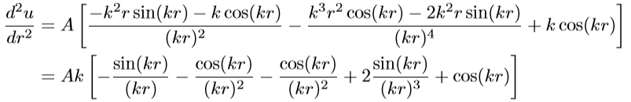



Problem 4.8 page 144:
(a)

Slide 8

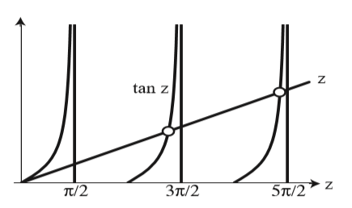


(b)
Large n, high z

Slide 9


Problem 4.9 page 145

Slide 10

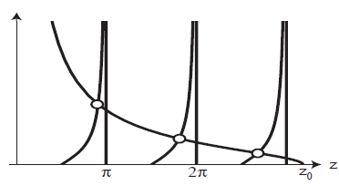


Slide 11






Problem 4.13 page 155
(a)
(b)

Slide 12

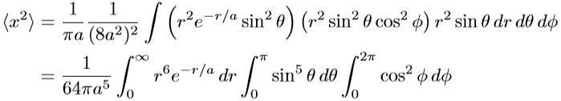


(c)

Slide 13



Problem 4.14 page 156
Problem 4.15 page 156
(a)
(b)
6.8eV

Slide 14










Problem 4.16 page 158
Lyman series:

Slide 15







Problem 4.17 page 159
(a)
(b)
(c)

Slide 16









(d)

Slide 17









(one light year)

Slide 18







Problem 4.18 page 166

Slide 19


Problem 4.19 page 166
(a)
(b)
(c)
(d)

Slide 20






Problem 4.20 page 167
(a)

Slide 21


(b)

Slide 22




Problem 4.24 page 170
(a)
(b)
The degeneracy is 2n+1

Slide 23




Problem 4.25 page 172

Slide 24












Problem 4.27 page 177
(a)
(b)
0
(c)
(d)

Slide 25









Problem 4.28 page 177

Slide 26








Problem 4.29 page 177
(a)
(b)
(c)

Slide 27






Problem 4.30 page 178

Slide 28








Problem 4.31 page 178

Slide 29
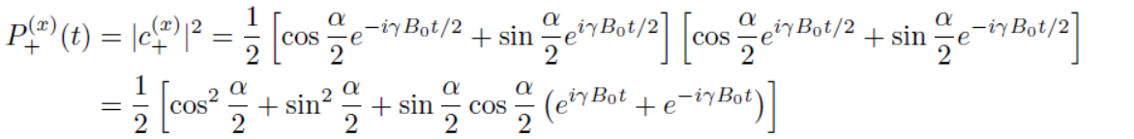

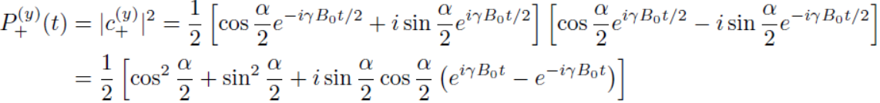

Problem 4.32 page 183
(a)
(b)

Slide 30



(c)

Slide 31








Problem 4.33 page 184
(a)
(b)

Slide 32







(c)
(d)

Slide 33




Problem 4.34 page 184
(a)
(b)

Slide 34
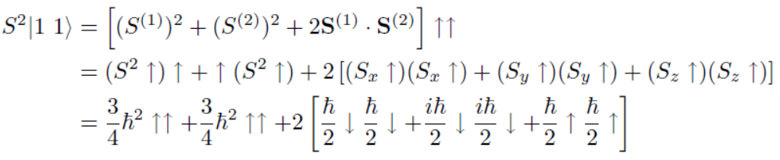

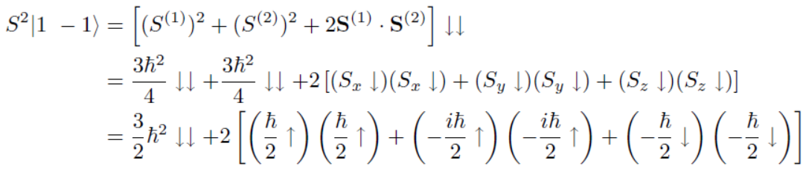

(c)

Slide 35






Problem 4.38 page 190
(a)
(b)

Slide 36

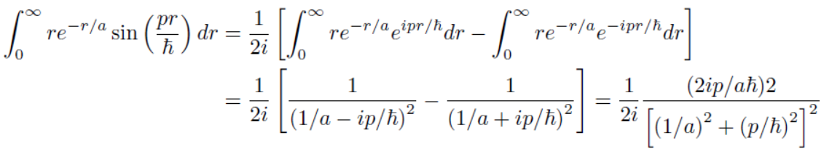

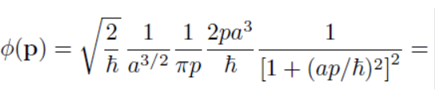

Problem 4.42 page 196
(a)

Slide 37
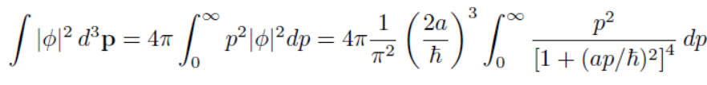



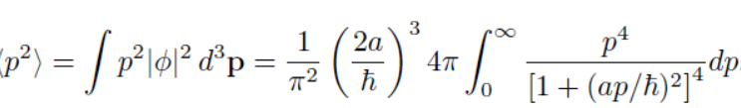




(b)
(c)
(d)

Slide 38

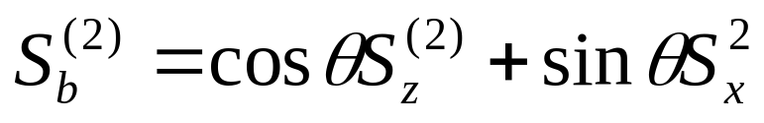




Problem 4.50 page 194
Choose axes that a lies along the z, and b in the xz plane,then:

Slide 39
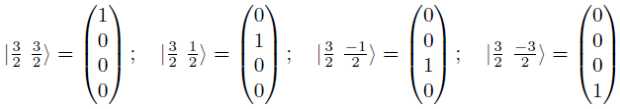




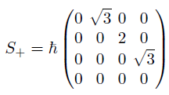
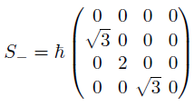
Problem 4.53 page 195

Slide 40
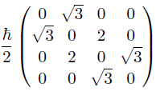

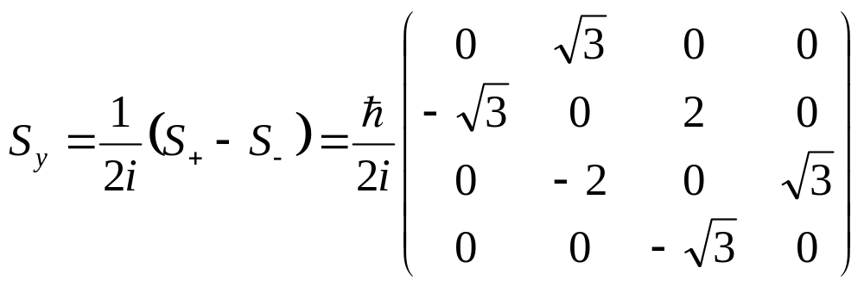
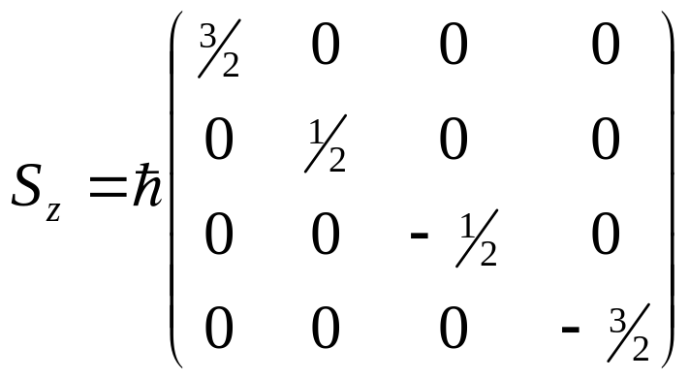


Slide 41








Problem 4.55 page 196
(a)
(b)
(c)
(d)
(e)

Slide 42



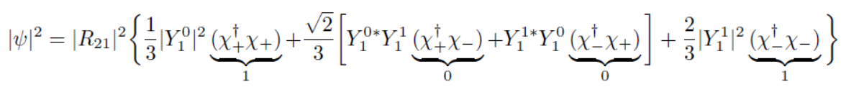




(f)
(g)
(h)

Slide 43
Homework:
problem 35
Problem 36
Problem 37
Problem 49
Problem 52

